Slide 1


Team Communication for the 21st Century
Welcome aboard! This guide is meant to help you get started and make work for you!
Aon Voluntary Benefits & Enrollment Solutions
Prepared by: Greg Piela

Slide 2
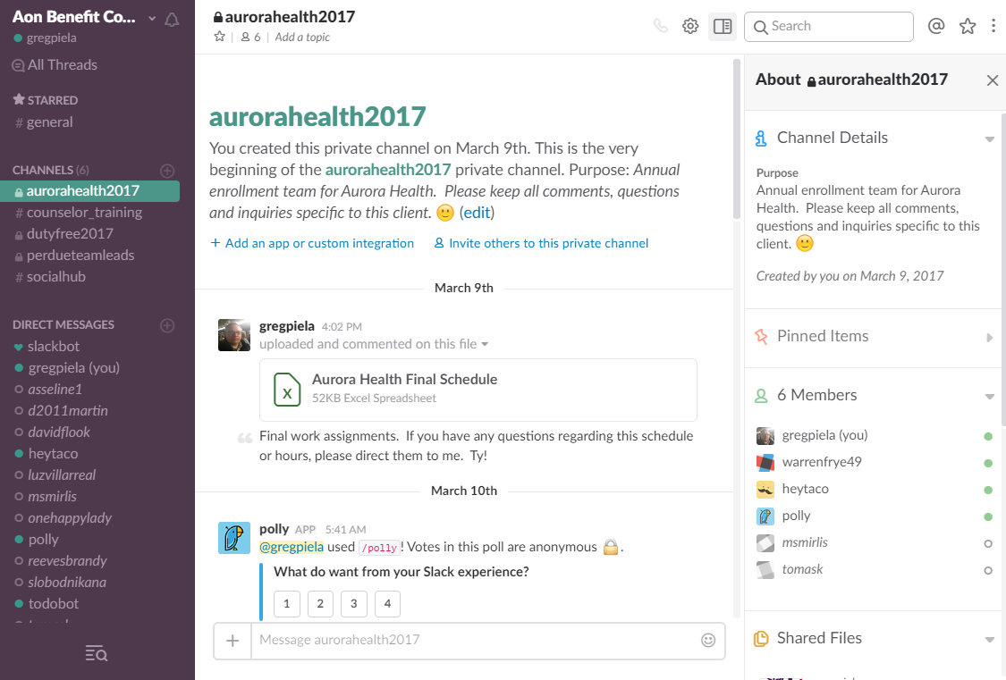

What is Slack?
At it’s heart, Slack is an instant messaging and collaboration system on steroids. Slack brings real-time messaging, archiving and search all together in one place. However, there is a lot “under the cover.” So let’s take a look at some of the basics.
Today’s agenda will cover:
Slack: The Basics
Private Channels
Direct Messaging
File Sharing
Search Capabilities
Slack: In Depth
Mentions vs Announcements
Message Threads
Format your Messages
Prioritize with Stars
Organize Channels & DMs
Aon Voluntary Benefits & Enrollment Solutions
Proprietary & Confidential

Slide 3
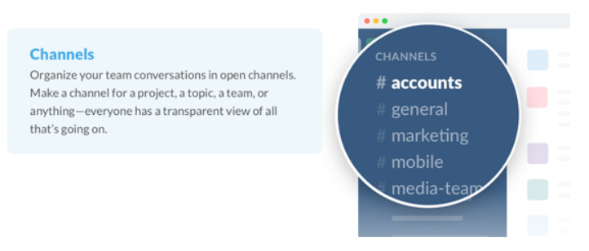
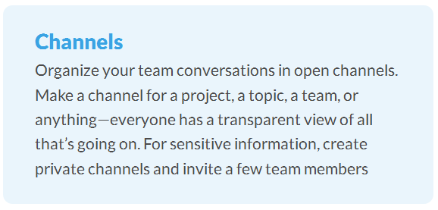
Channels: where the magic happens!
This transparency means that it’s quick to find out what is going on all across the team.
When someone new joins the team, all previous information is laid out and ready to use.
This would include, team projects, training items, shared documents, upcoming events, etc.
Aon Voluntary Benefits & Enrollment Solutions
Proprietary & Confidential

Slide 4
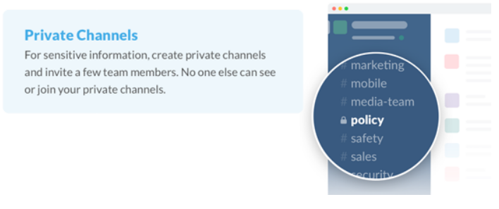
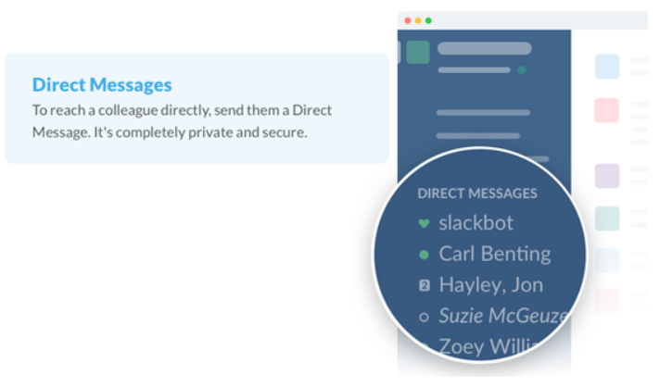
Private Channels vs Direct Message
Creates an “uncluttered” work environment for specific cases, teams & projects
Robust texting/messaging features
Greatly reduces unnecessary emails, texts and phone calls
Aon Voluntary Benefits & Enrollment Solutions
Proprietary & Confidential

Slide 5
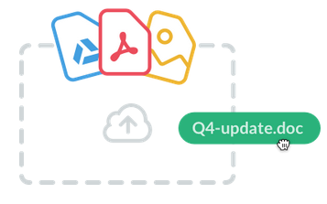
Share Your Files
The ability to share files and documents is a cornerstone of collaboration basics. Slack allows you “house” files within your team’s archives.
Drag
Drop
Share
Not just your messages, but all your files, images, PDFs, documents and spreadsheets can be dropped right into Slack.
Add comments & star for later reference
Completely searchable
If you use services such as Google Drive, Dropbox or Box, just paste the link and that document immediately syncs in Slack!
Aon Voluntary Benefits & Enrollment Solutions
Proprietary & Confidential

Slide 6
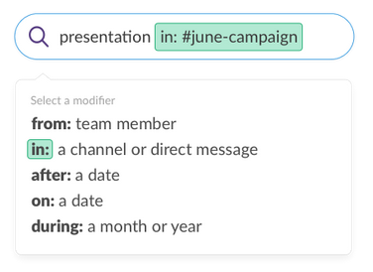
Search Capabilities
Slack’s robust search functionality enables you to find key information quickly, even if it’s inside a document you shared.
Search your entire archive.
Everything in Slack – messages, notifications and all – is automatically indexed and archived so that you can have it at your fingertips whenever you want.
Slack also indexes the content of every file so you can search within PDFs, Word documents, Google docs and more.
With one search box and a set of powerful search operators, you can “slice and dice” your way to that one message in your communication haystack.
Aon Voluntary Benefits & Enrollment Solutions
Proprietary & Confidential

Slide 7
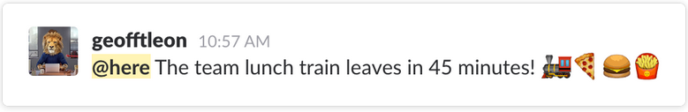
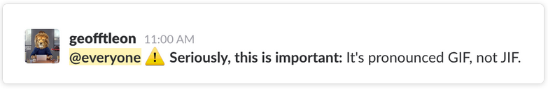
Mentions versus Announcements
Mentions: While holding a conversation in a channel, you may need to call the attention of a team member. Type @username/name in your message to grab their attention!
Announcements: What if you need to send a message to the everyone in a specific channel or the entire team?
@here mentions lets you notify just the team members that are currently active
@channel will send a notification to all team members in the channel you posted
@everyone notifies everyone on your team.(Only in the #general channel)
Aon Voluntary Benefits & Enrollment Solutions
Proprietary & Confidential

Slide 8
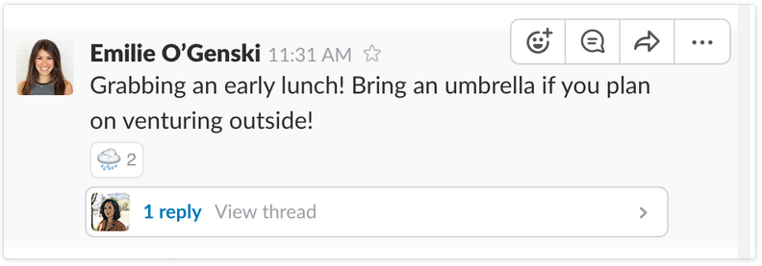
Messages Threads
Threads let you respond directly to a message in a channel, keeping the replies organized neatly in a single, threaded conversation. Go ahead, ask questions and dig deeper, have side conversations, or go on a tangent without interrupting the flow of conversation.
Why use threads?
Encourage open discussion without distracting others.
Organize conversations and preserve meaningful context.
Focus your time and attention on the task at hand
How to reply?
Hover over the message
Click on the reply bubble icon or on any message that already has replies
Compose message
Hit send
Aon Voluntary Benefits & Enrollment Solutions
Proprietary & Confidential

Slide 9
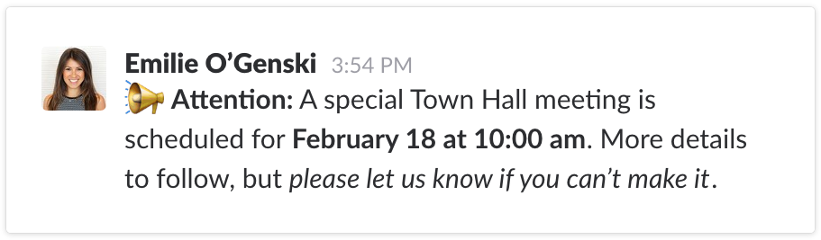
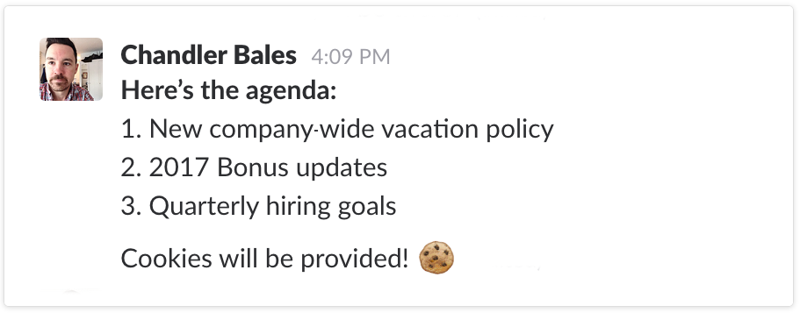
Format your Messages!
Adding text formatting to your Slack messages is easy! Here's a handy selection of formatting options:
Emphasis: To emphasize words or phrases, surround your text with *asterisks* to create bold text, or _underscores_ for italic text.
Lists: To create a list, use Shift+Enter to create new lines in your message, then add a number or a bullet (•) before each item.
Aon Voluntary Benefits & Enrollment Solutions
Proprietary & Confidential

Slide 10
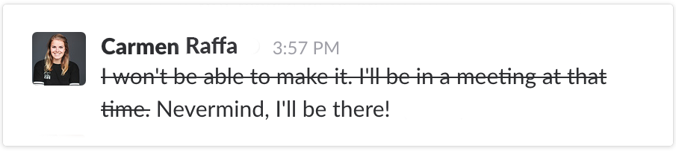
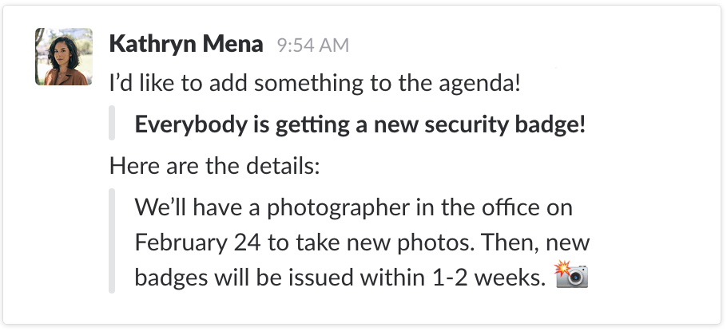
More on Formatting…
Need to add a little more panache to your messages? Here are a couple more formatting ideas…
Strikethrough: Try using strikethrough to show corrections in your messages, or mark completed items on a to-do list. Surround your text with ~tildes~ to strike out.
Blockquotes: Add angle brackets to the beginning of your message for an indent or blockquote:
> to indent one paragraph
>>> to indent multiple paragraphs
Aon Voluntary Benefits & Enrollment Solutions
Proprietary & Confidential

Slide 11
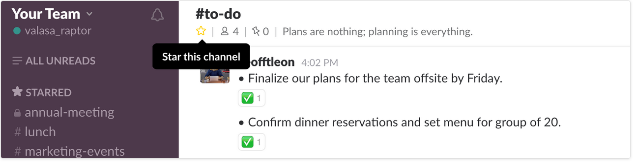

Prioritize with Stars
Starring: Prioritize what is important to you!
Stars are a way to mark an item as important in Slack. You can star channels, direct messages and documents:
Moves all items to top left sidebar… for easy reference!
Any starred items are only for you, pinned items are for groups/teams
Aon Voluntary Benefits & Enrollment Solutions
Proprietary & Confidential

Slide 12
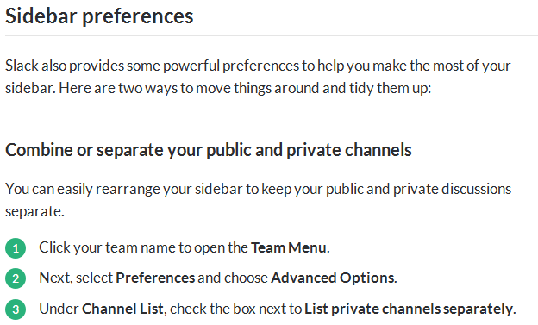
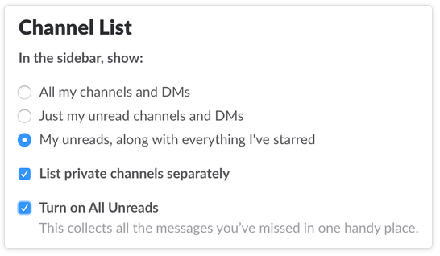
Organize Channels & Direct Messages
Every Slack team starts with two channels: #general and #random. Adding more channels helps you have more specific and focused conversation and that’s good! But as your team grows, you’ll want to keep your most important conversations just where you need them.
Here are just a few simple ways of filtering the busy hum of productivity in your sidebar:
Aon Voluntary Benefits & Enrollment Solutions
Proprietary & Confidential

Slide 13
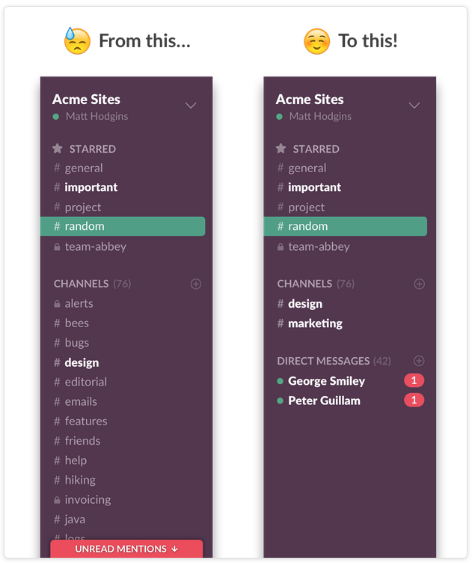
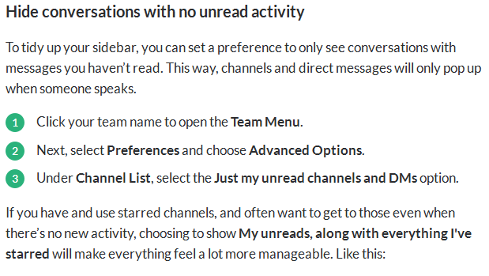
More on Channels & Direct Messages
Another “best practice” tip on organizing your communications…
Aon Voluntary Benefits & Enrollment Solutions
Proprietary & Confidential

Slide 14

Questions?
Thank you, but what if I have questions?
There is a host of video how-to links and articles at www.slack.com
Or, you can email me directly at:
brandy.reeves@aon.com
Thank you and we hope this was helpful!
Aon Voluntary Benefits & Enrollment Solutions
Proprietary & Confidential

